Slide 1
Object templates

Slide 2
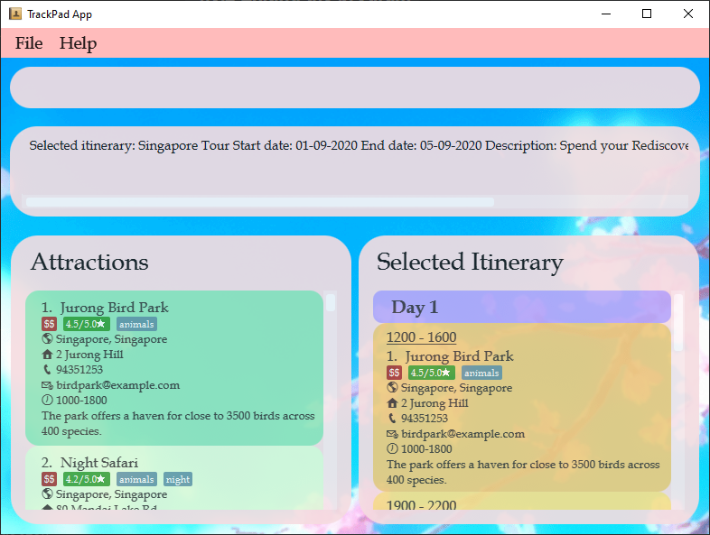
Notes:
ItineraryAttraction.png
Figure 17. Diagram simulating the attractions found in an itinerary

Slide 3
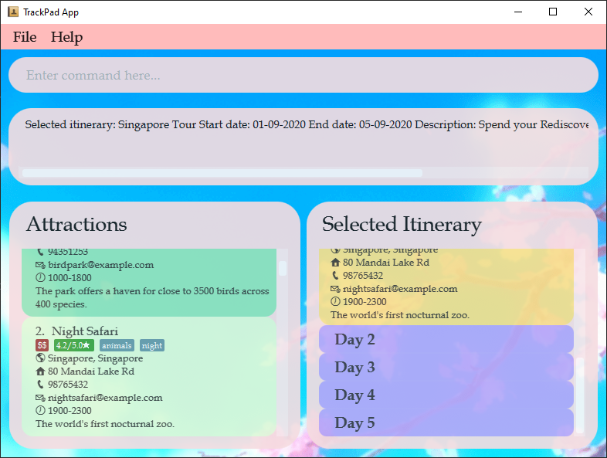
Add this
attraction
into Day 2
Notes:
AddItineraryAttraction1.png

Slide 4
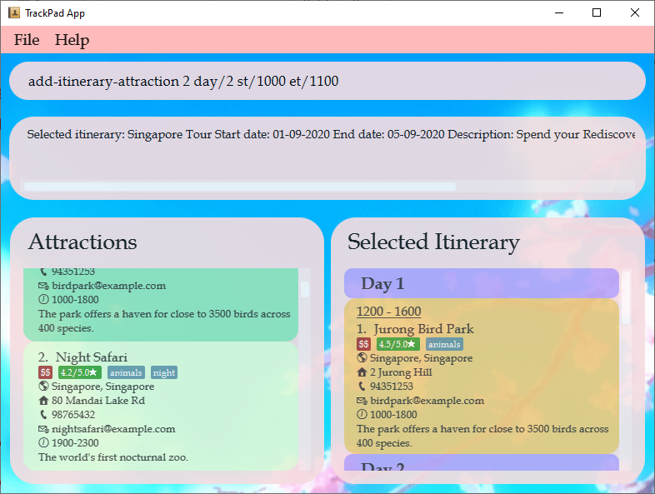
Enter command here
Notes:
AddItineraryAttraction2.png

Slide 5
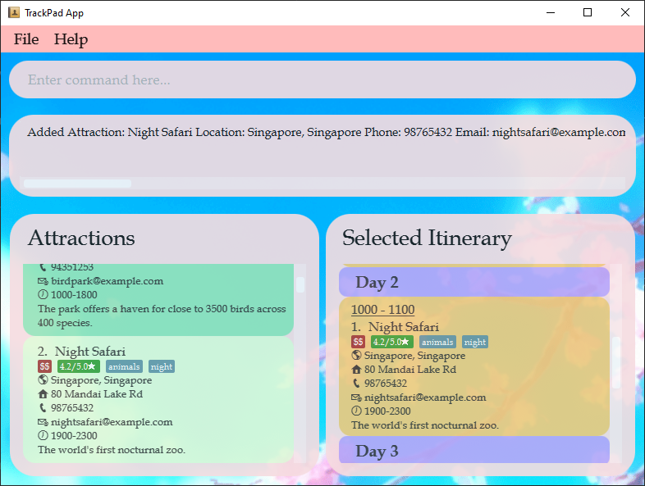
Attraction has been added
Notes:
AddItineraryAttraction3.png

Slide 6
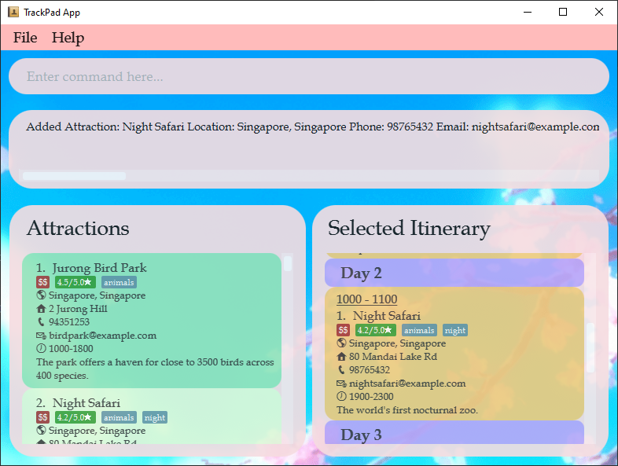
Visiting at 1000H
Notes:
EditItineraryAttraction1.png

Slide 7
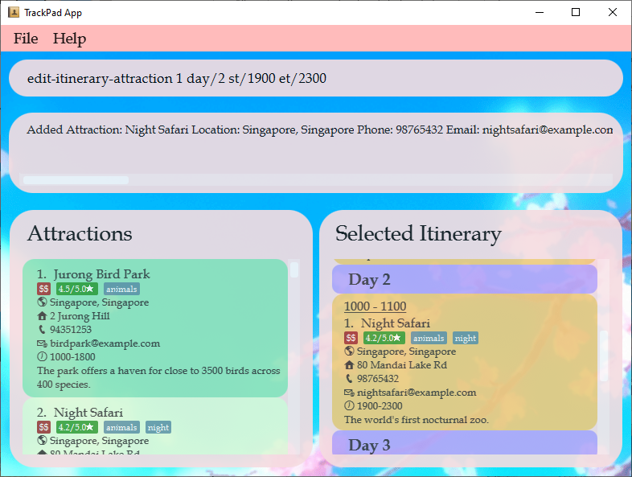
Enter command here
Notes:
EditItineraryAttraction2.png

Slide 8

Changed to visiting at 1900H
Notes:
EditItineraryAttraction3.png

Slide 9
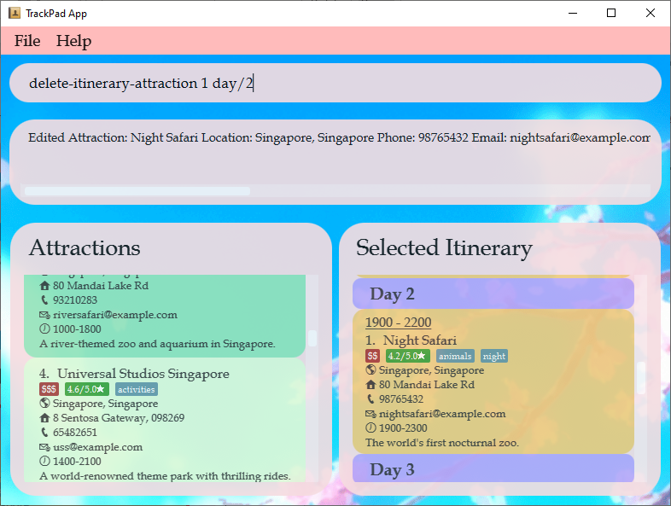
Enter command here
Currently 1 attraction in Day 2
Notes:
DeleteItineraryAttraction1.png

Slide 10
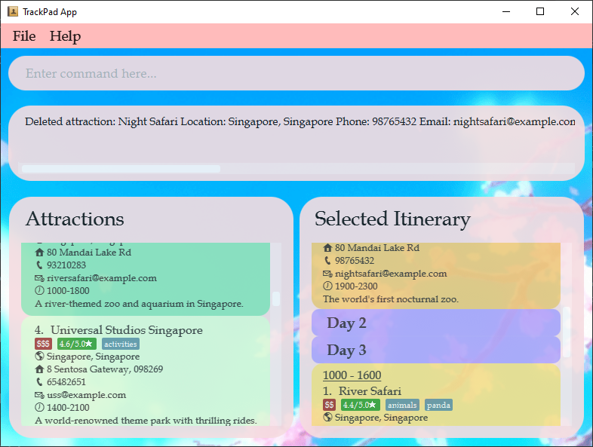
Day 2 is now empty
Notes:
DeleteItineraryAttraction2.png

